Slide 1
PriMa
Privacy Matters
Raymond Veldhuis - Coordinator
H2020-MSCA-ITN-2019
ETN - 860315
01-01-2020 – 31-12-2023

Slide 2
Why?
emotional state,
sexual preference,
gender, age,
ethnicity,
health,
job,
…

Slide 3
What – Objectives
To train 14 creative, entrepreneurial, and innovative researchers as privacy protection experts.
To contribute to a full understanding of the multidisciplinary nature of privacy protection in a digitalised society.
To contribute to the development of solutions that address this important societal challenge.

Slide 4
How?
With 3.8M€ from the EU and …

Slide 5
7 Beneficiaries
University of Twente (UTW)
University of Kent (UNIKENT)
Norges teknisk-naturvitenskapelige universitet (NTNU)
Norsk Regnesentral (NR)
Univerity of Würzburg (UNIWUE)
KU Leuven
Universidad Autonoma de Madrid (UAM)

Slide 6
7 Partner Organisations
GenKey Solutions B.V.
Secunet Security Networks AG
Fraunhofer IGD
TNO
Triodos Bank NV
Software Improvement Group B.V
Callsign Inc.

Slide 8
And, of course, with 14 briljant ESRs

Slide 9
Purpose of this Kickoff
To get to know each other
To learn about the project
To start the training

Slide 10
Agenda

Slide 11
Monday 30.11.2020
08:30 – 09:00 | Arrival
09:00 – 09:15 | Opening - Raymond Veldhuis (coordinator) Meeting start - Goals of the meeting – Agenda
09:15 – 09:45 | About PriMa – Raymond Veldhuis and Richard Guest
09:45 – 10:45 | Research Training – Part 1/3 State-of-the-art in biometrics and machine learning – Raymond Veldhuis
10:45 – 11:15 | Grab your coffee/tea
11:15 – 12:15 | Introduction of ESRs
 | 11:15 -11:30 |  | ESR 1 | 11:30 – 11:45 |  | ESR2
 | 11:45 – 12:00 |  | ESR 3 | 12:00 – 12:15 |  | ESR 6
12:15 -- 13:15 | Virtual Café Lunch
13:15 – 14:15 | Introduction of ESRs
 | 13:15 – 13:30 | ESR 4 |  | 13:30 – 13:45 | ESR 8
 | 13:45 – 14:00 | ESR 5 |  | 14:00 – 14:15 | ESR 13
14:20 | Small pause
14:45 – 16:45 | Fun activity – Virtual Escape Room | Fun activities – Virtual Escape Room
17:00 – 17:15 | Gather in main Teams room
17:15 – 18:15 | Virtual Meet your supervisor and co-supervisors
18:15 – 19:00 | Virtual Café for Dinner
19:00 – 20:30 | Pub Quizz – Winning team gets a prize

Slide 12
Tuesday 01.12.2020
08:30 – 09:00 | Arrival (grab your coffee/tea)
09:00 – 10:45 | Continue Introduction of ESRs
 | 9:00 – 9:15 | ESR 7 | 9:15 – 9:30 | ESR 12
 | 9:30 – 9:45 | ESR 9 | 9:45 – 10:00 | ESR 11
 | 10:00 – 10:15 | ESR 10 | 10:15 – 10:30 | ESR 14
10:30– 11:00 | Grab your coffee/tea
11:00 – 12:10 | Company Pitches
 | 11:00 – 11:10 | GenKey Solutions B.V | 11:10 – 11:20 | Secunet
 | 11:20– 11:30 | Fraunhofer IGD | 11:30 – 11:40 | TNO
 | 11:40 – 11:50 | Triodos Bank NV | 11:50 – 12:00 | Software Improvement Group
 | 12:00 – 12:10 | CallSign L.T.D
12:10 – 13:15 | Virtual Café Lunch
13:00 - 14:00 | Research Training – Part 2/3 Setting up of experiments including data collection and evaluating results – Luuk Spreeuwers
14:00 – 14:30 | Research Training – Part 3/3 Discussion with Raymond
14:30 – 15:30 | Transferable Skills Training: a) How to organise ideas – Rob Heyman
15:30 – 16:00 | Grab your coffee/tea
16:00 – 17:00 | Transferable Skills Training: b) Research Integrity – Miles MacLeod
17:00 | Closing

Slide 13
Wednesday 02.12.2020
08:30 – 09:00 | Arrival (grab your coffee/tea)
09:00 – 10:00 | Transferable Skills Training: c) Work Planning & Time management – Cees Harmsen
10:00 – 10:30 | Grab your coffee/tea
10:30 – 11:30 | Transferable Skills Training: d) Open Access and Data Management – Petri Willigen
12:00 -13:00 | Virtual Café Lunch
13:00 – 14:00 | ESRs and Supervisors and co-supervisors continue to Meet
14:00 | Closing of Kick-Off

Slide 14
More about PriMa
General – Raymond Veldhuis
Training and Secondments – Richard Guest

Slide 15
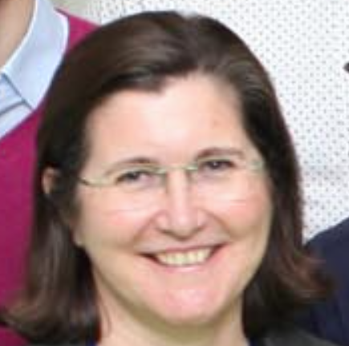
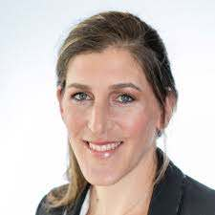
Important information
Project Officer
https://www.prima-itn.eu
Description of Action (on website)
Program manager – Bridgette Connell
Training
Research Projects
Training Events
Secondments

Slide 16
Management Structure

Slide 17
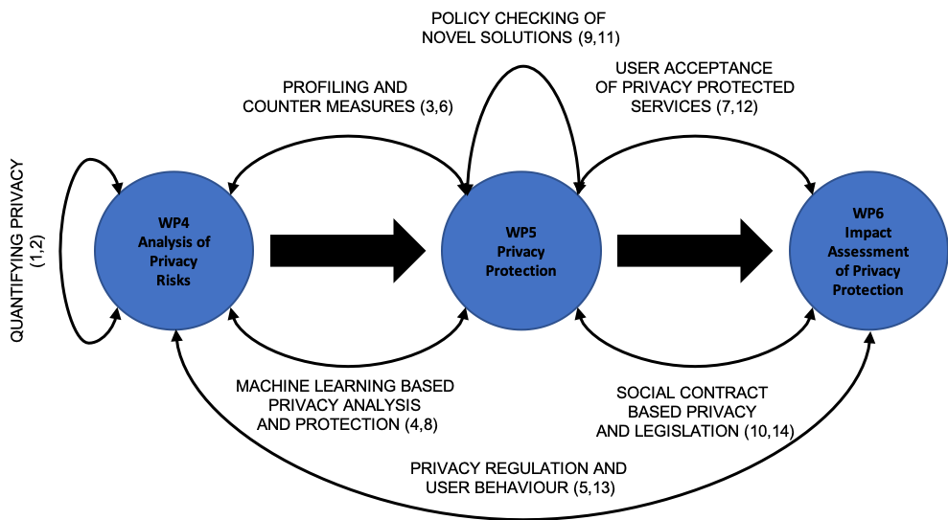
3 Technical WPs 14 ESR projects, organised in pairs

Slide 18
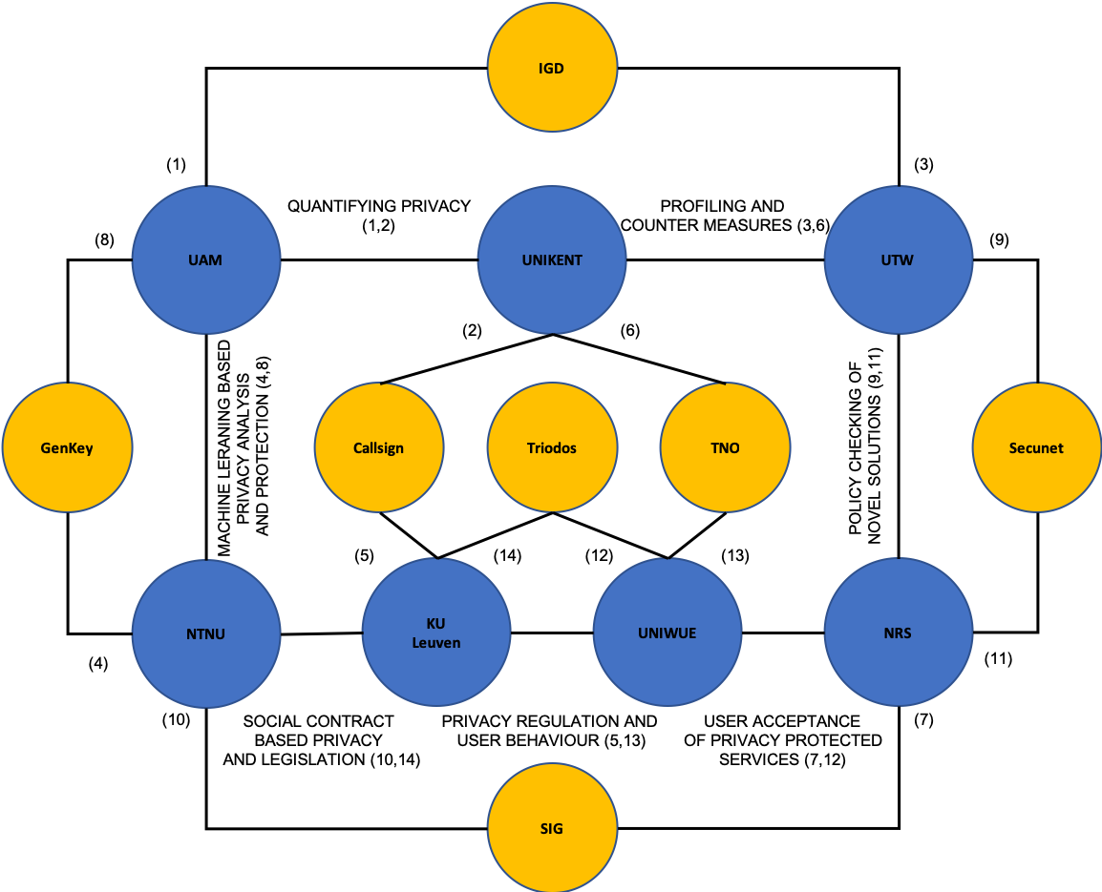
Beneficiaries (7)
Partner Organisations (7)
Paired projects (7 x 2)
2 Secondments/ESR

Slide 19
Training and Secondments
Richard Guest

